Slide 1

Python Scripting with Network
Day 14

Slide 2

Agenda
Network Inventory Tools in Python
Exception Handing
Network Testing & Validation
SD-WAN Network Automation

Slide 3
Network Inventory Tools in Python
Automated network inventory Python scripts significantly enhance accuracy by continuously discovering devices and updating records in real-time. They reduce human error, ensure consistency, and enable rapid detection of unauthorized or rogue devices.
Furthermore, automation supports regulatory compliance by maintaining detailed, auditable records of network assets, configurations, and changes.
Implementing network discovery Python scripts that leverage CDP and LLDP involves querying network devices via SNMP or directly parsing device configurations. For example, using Python libraries such as pysnmp or netmiko, engineers can automate retrieval of neighbor information.

Slide 4
Exception Handling
Python categorizes errors into a well-defined hierarchy rooted in the BaseException class, with Exception serving as the base for most user-defined and standard errors. Built-in exceptions such as ValueError, KeyError, TimeoutError, and ConnectionError are common in network automation contexts, arising from issues like invalid input, failed device connections, or command timeouts.
Logging levels such as DEBUG, INFO, WARNING, ERROR, and CRITICAL allow filtering messages based on severity. For network scripts, ERROR and WARNING are crucial for identifying issues without overwhelming logs with verbose details.

Slide 5
Network Testing & Automation
The pyATS framework, developed by Cisco, is a comprehensive platform designed for automated network testing and validation.
Its modular architecture enables network engineers to create scalable, repeatable test environments—referred to as testbeds—that simulate complex network topologies.
The core components include testbed definitions, device connections, and test scripts, each playing a crucial role in automating network testing pyATS pytest workflows.
pytest is a versatile testing framework that, when integrated with pyATS, empowers network engineers to write expressive, maintainable, and scalable network tests. Its support for fixtures, assertions, and comprehensive reporting makes it ideal for automated network validation.

Slide 6
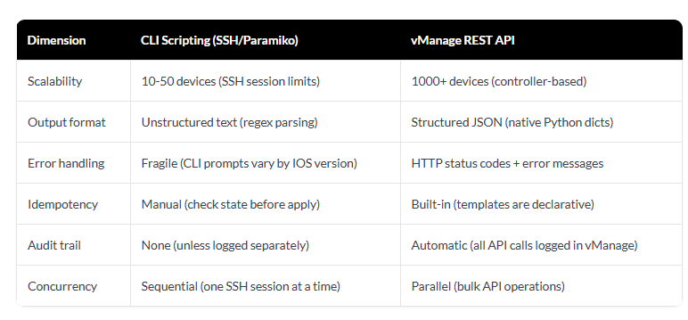
SD-WAN Network Automation
SD-WAN API automation uses programmatic interfaces—primarily REST APIs exposed by controllers like Cisco vManage—to configure, monitor, and orchestrate software-defined wide area networks at scale. Instead of clicking through GUI dashboards or typing repetitive CLI commands for hundreds of branch sites.

Slide 7
Wrap Up
Python Automation for Network engineering
Python Network Libraries
Python logging data parsing
Python Reporting

